Slide 1


Guillaume Lagacé
gl@happyboxcms.com
happyboxcms.com
July 3, 2013

Slide 2
What is HappyBox?
HappyBox teaches people how to perfectly brand themselves to help them serve and sell a product, a service or a point of view.

Slide 3
Why HappyBox?
Everybody need to be online today.
Therefore everybody needs to sell themselves if they are online.
The problem is most people have no clue how to create a message around their product or a service.

Slide 4
Three Pillars to Happiness
Our Learnification process teaches the do's and don't on how to brand a service, a product or a point of view. No more bad messaging and horrible branding on your website.
Think Mobile First. HappyBox built a cutting-edge platform that is accessible from anywhere, anytime on any device using a host of responsive technologies.
Own your content. Every HappyBox users get a slice of the cloud with their own data with a focus on maximum flexibility.

Slide 5
3 Steps Revenue Model
Freemium
Individual
VIP
Freemium is all about the people.
HappyBox thinks community first.
We want to be able to drive traffic and generate buzz to apply our upsale model.
Free for unpublished projects
The individual package allows customers to benefit from the full potential of HappyBox.
The pricing depends on how many active projects you want to publish.
Starts at 9,99$/month.
Big brands needs customized and large-scale hosting services and support for their national and international marketing campaigns.
Starts at 99,99$/month.

Slide 6
Underlying magic
Want to see more?
Take the tour!

Slide 7

Marketing Process
HappyBox has his own dedicated sales force team!
Blogging, press releases, community management, social marketing, promotional videos, events, online advertising and grassroot partnership with entrepreneurship centers are at the core of our customer acquisition strategy.

Slide 8
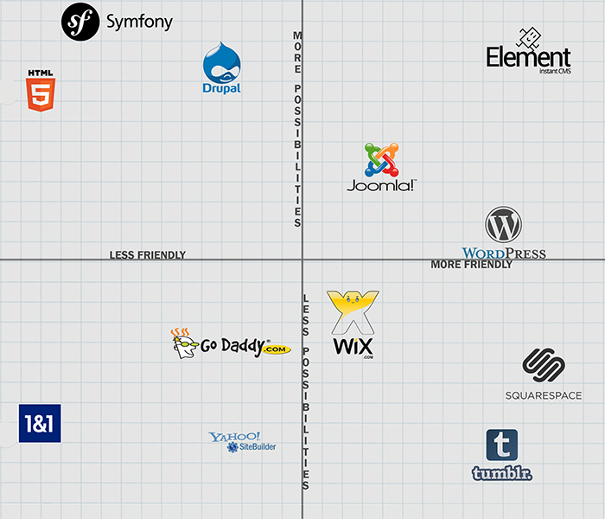
Competition

Slide 9




Management Team
Guillaume Lagacé
CEO
Danny Coulombe
CTO
Brendan Sera-Shriar
CCO
Brendan Tully Walsh
CMO
Our fabulous founder team happily counts on the full support of Fondation Montréal Inc. , SAJE Montréal Centre, CDEC Côte-des-Neiges and Coach Extraordinaire Davender Gupta.

Slide 10
Financial Projections
Financial Projections
 | 2013 | 2014 | 2015
Revenue | 60 000 | 600 000 | 2 800 000
Expense | 30 000 | 350 000 | 650 000
Net Profit | 30 000 | 250 000 | 2 150 000

Slide 11
Current status
First paid Individual customer | ✔
First paid VIP customer | ✔
Fondation Montreal Inc support | ✔
Hire staff (2) | ✔
Beta launch | July 14th
Capital Innovation - Défi Montréal | Soon...

Slide 12
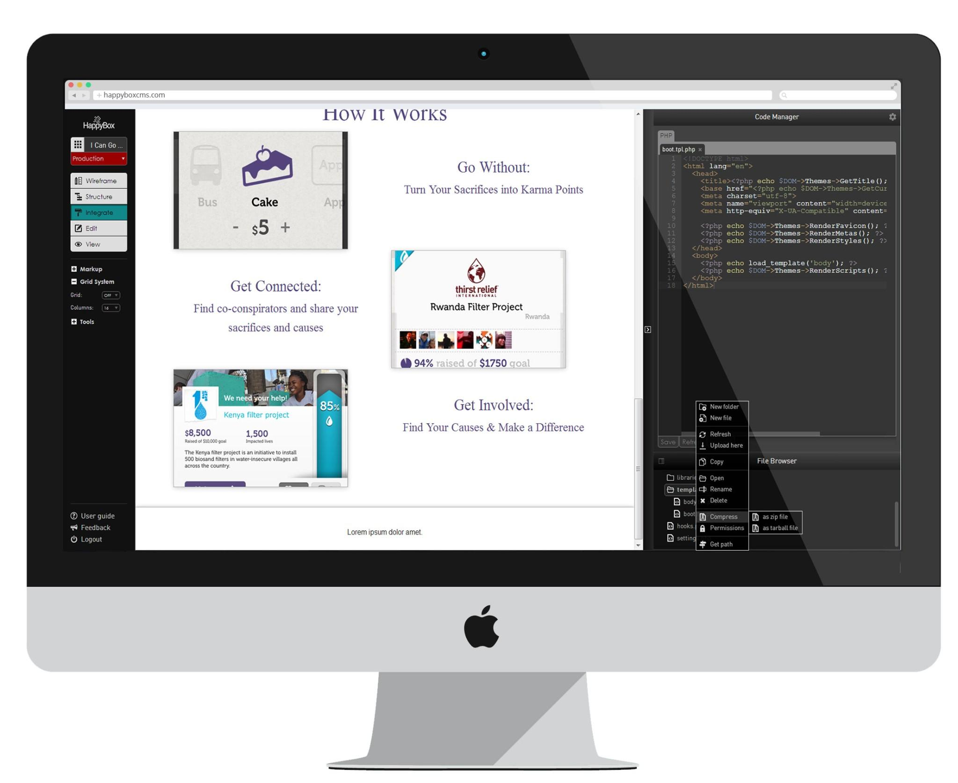
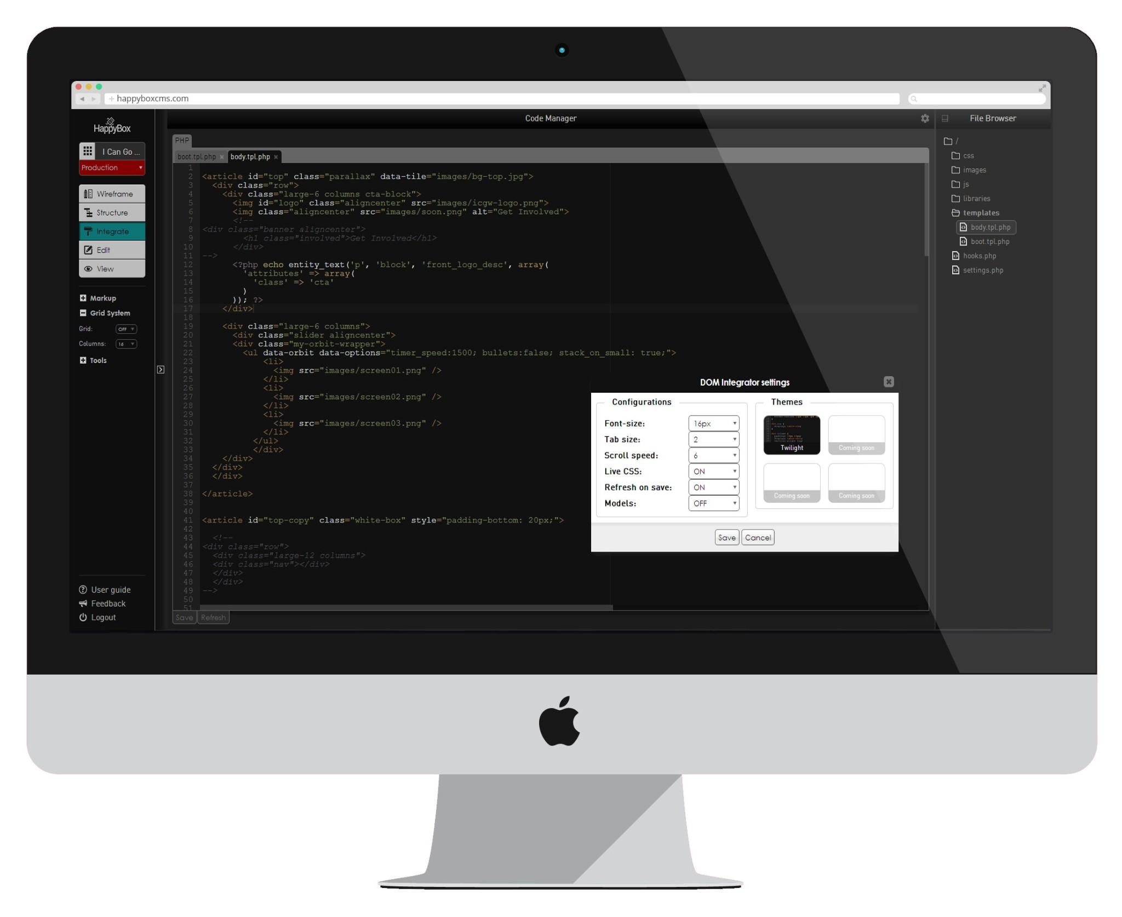
The next steps...
We've taken HappyBox to the next level with a professional package. In this pro version designers and developers will have access to our own custom Integrated Development Environment (IDE). Pro users will be able to take full advantage of the code and benefit from the full flexibility of a built-in IDE within HappyBox CMS.

Slide 13



